Slide 1

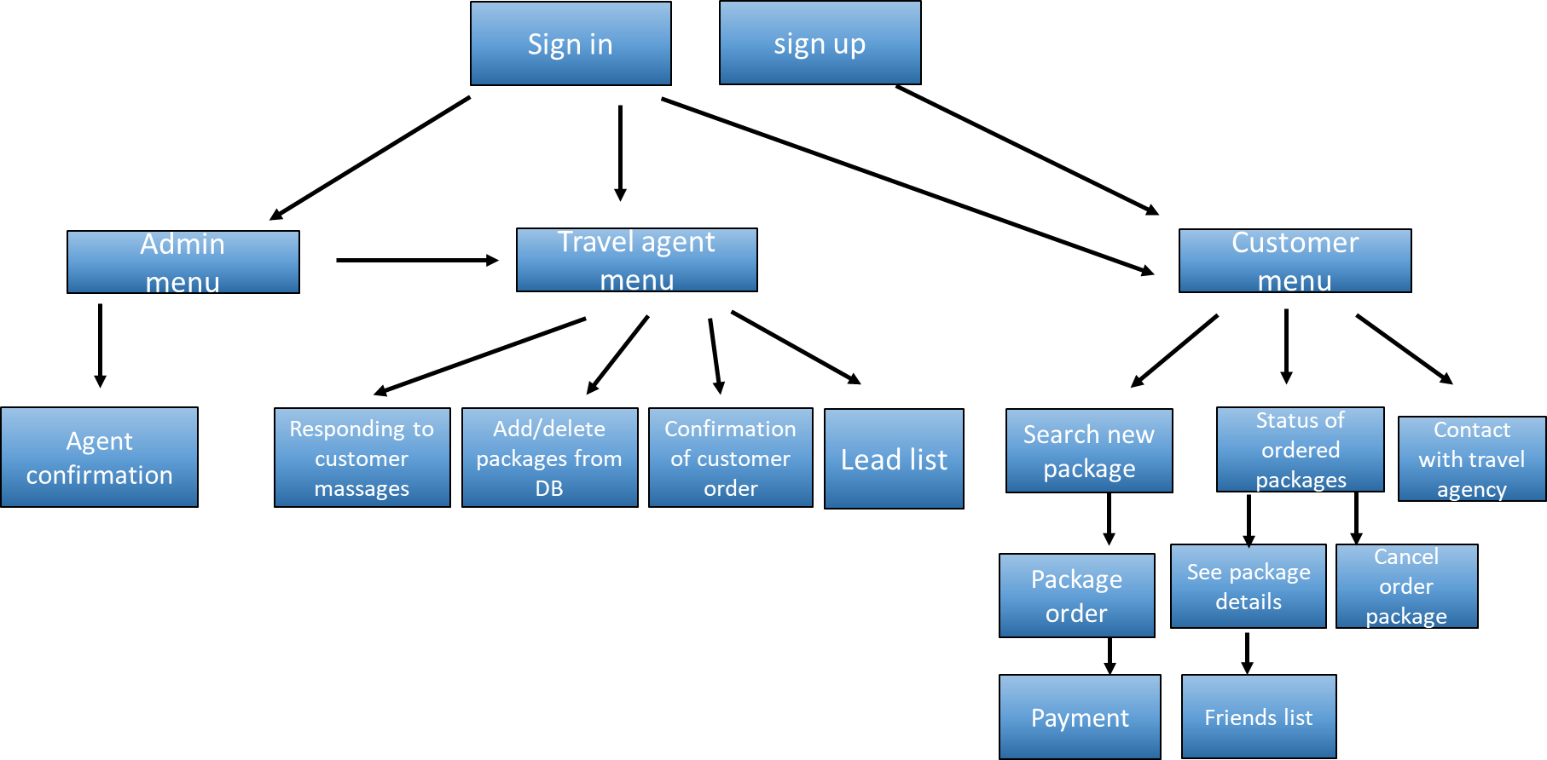
Travel agency
MADE FOR TRAVEL AGENCY IN ORDER TO IMPOVE DATA BASE AND INCREASE REVENUES BY USING A NEW ADVENCING OPPORTUNITIES TABLE SYSTEM

Slide 2

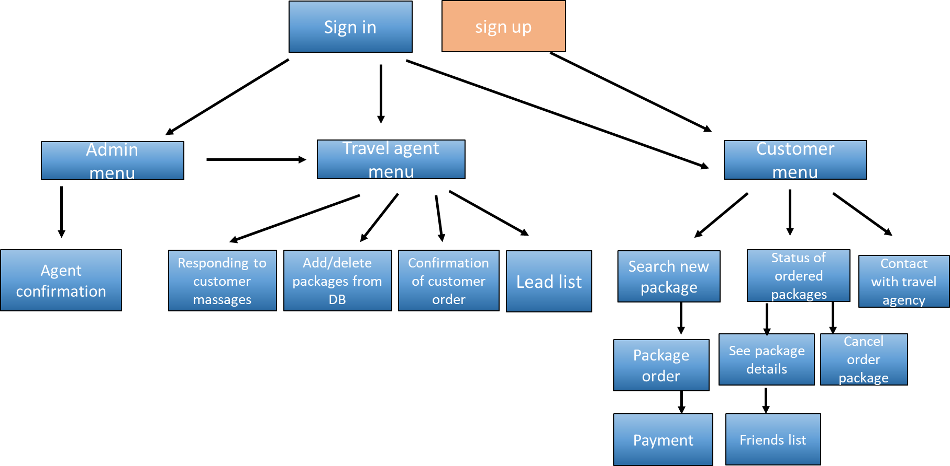
sign up screen

Slide 3

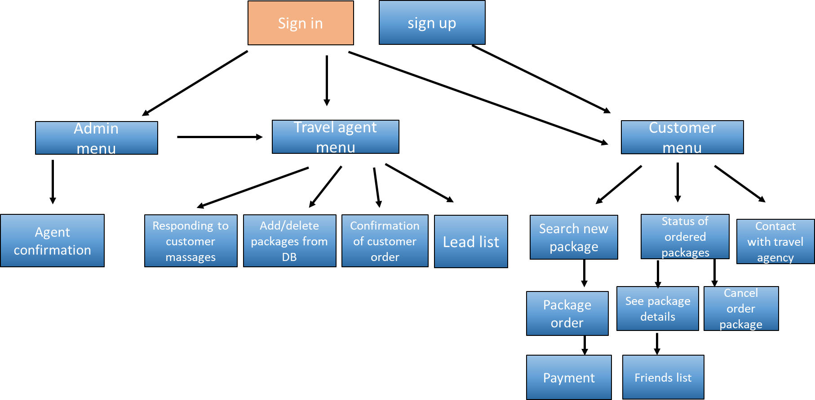
Log in screen

Slide 4

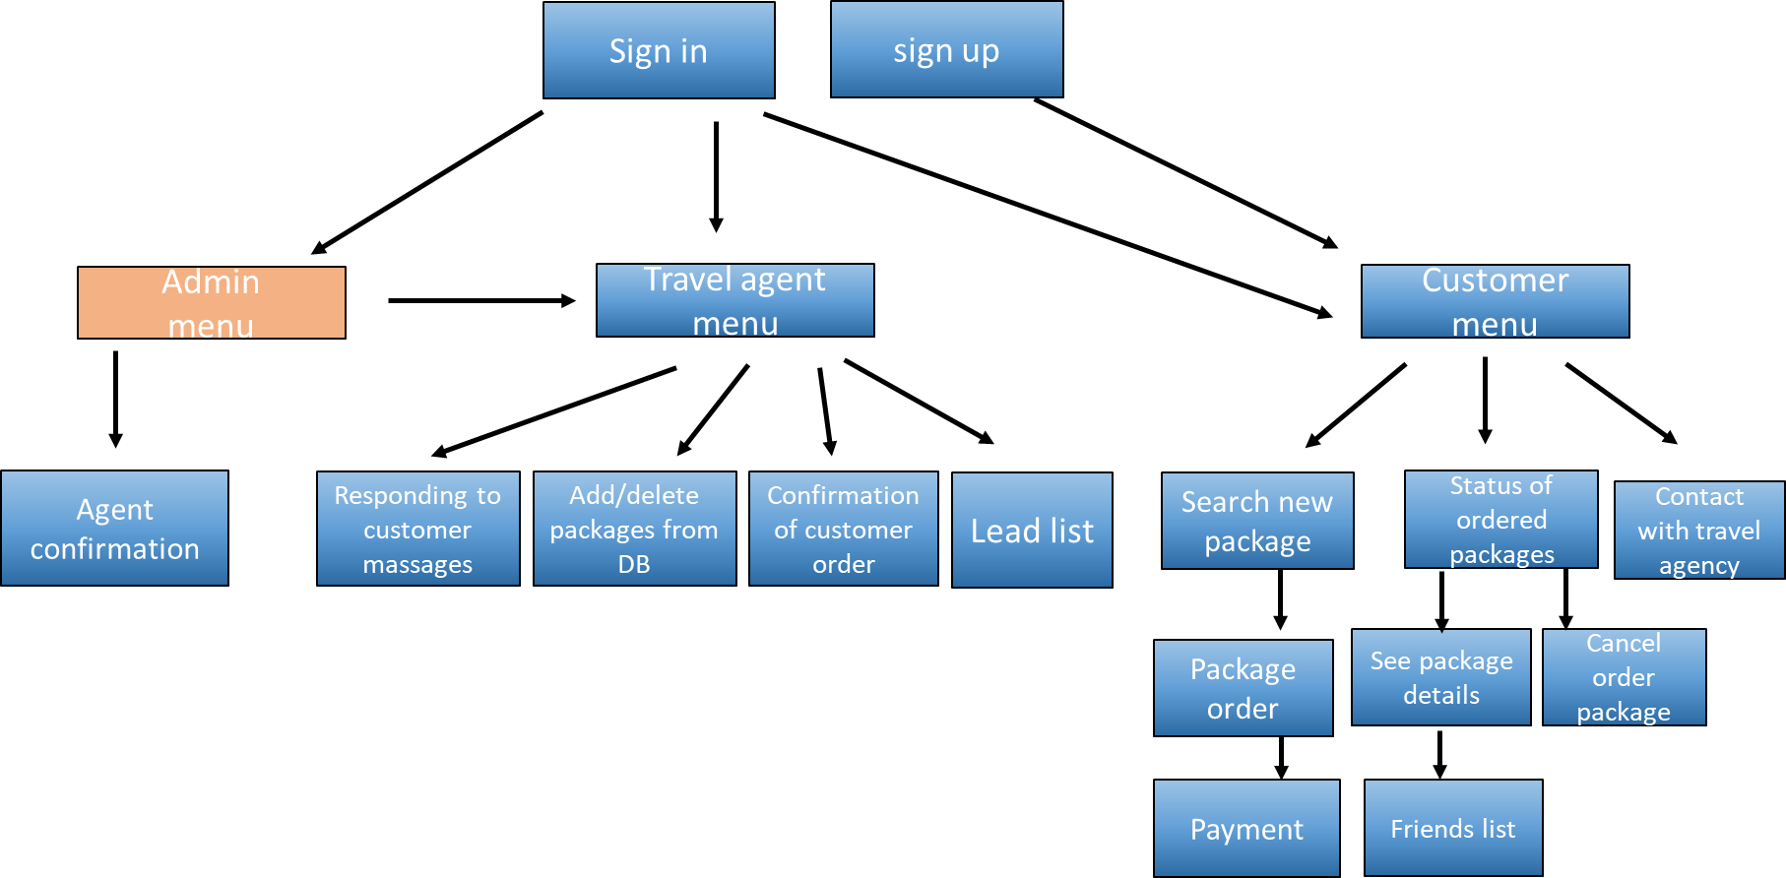

Admin
Confirmation agents
Agent menu
Home
Back

Slide 5
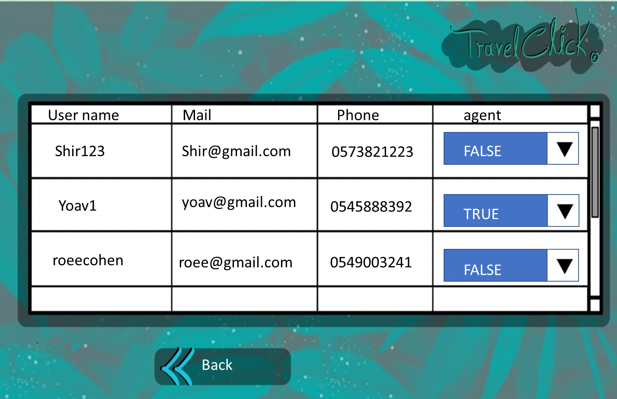
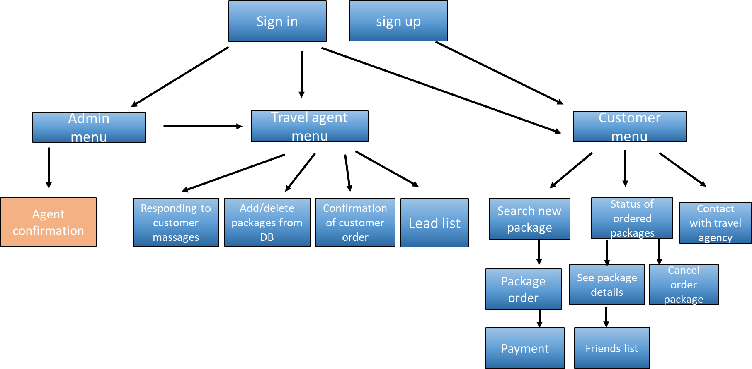

Slide 6

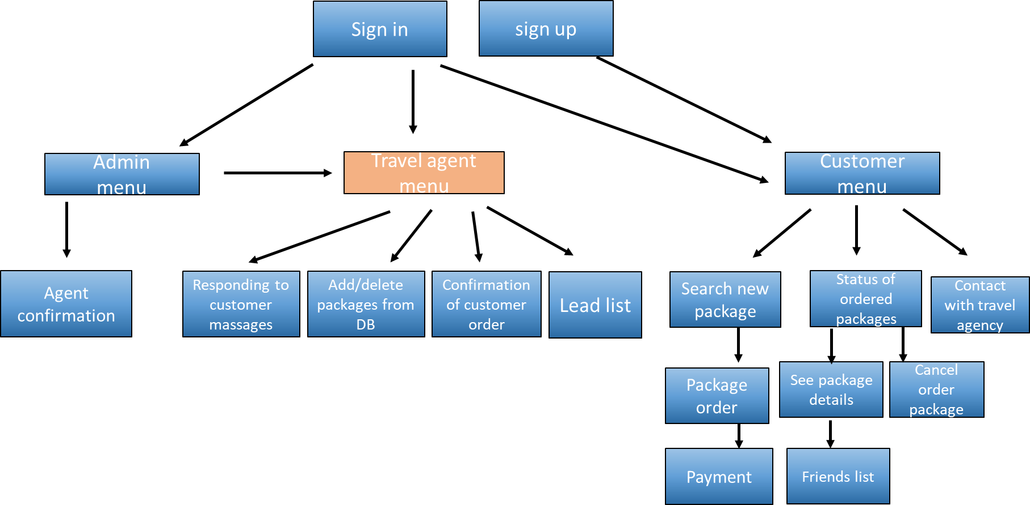
Agent 123
Confirmation of customer orders
Responding to customer calls
Add/ delete packages from DB
Lead list
Home
Back

Slide 7

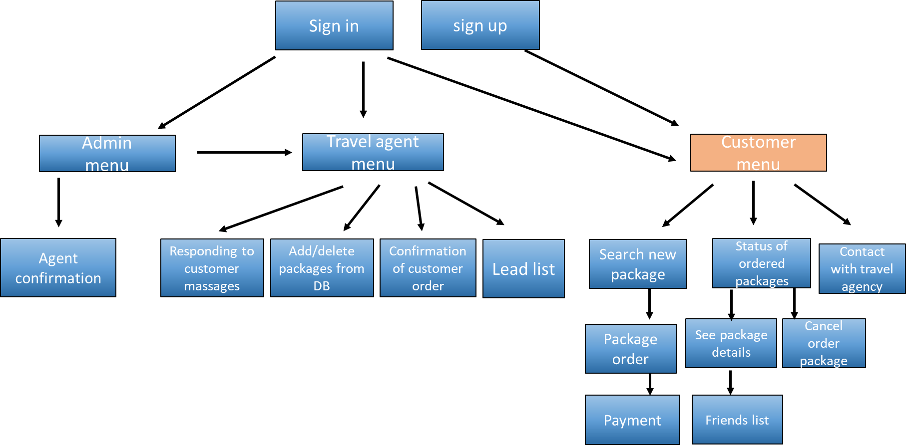

User 123
Search new package
Status of ordered packages
Contact with travel agency
Home
Back

Slide 8

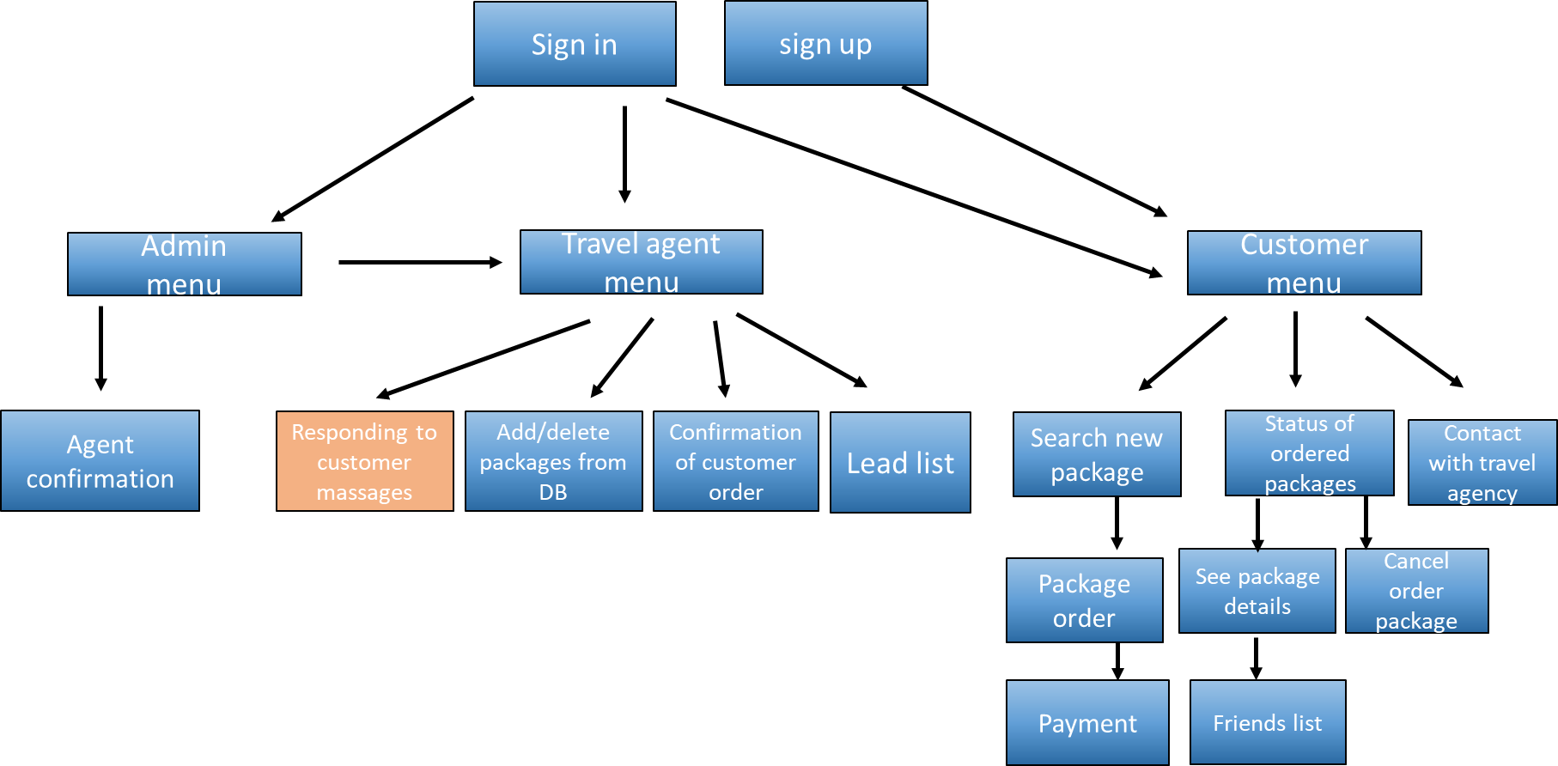
Pending messages
Taken care of
Home
Back

Slide 9

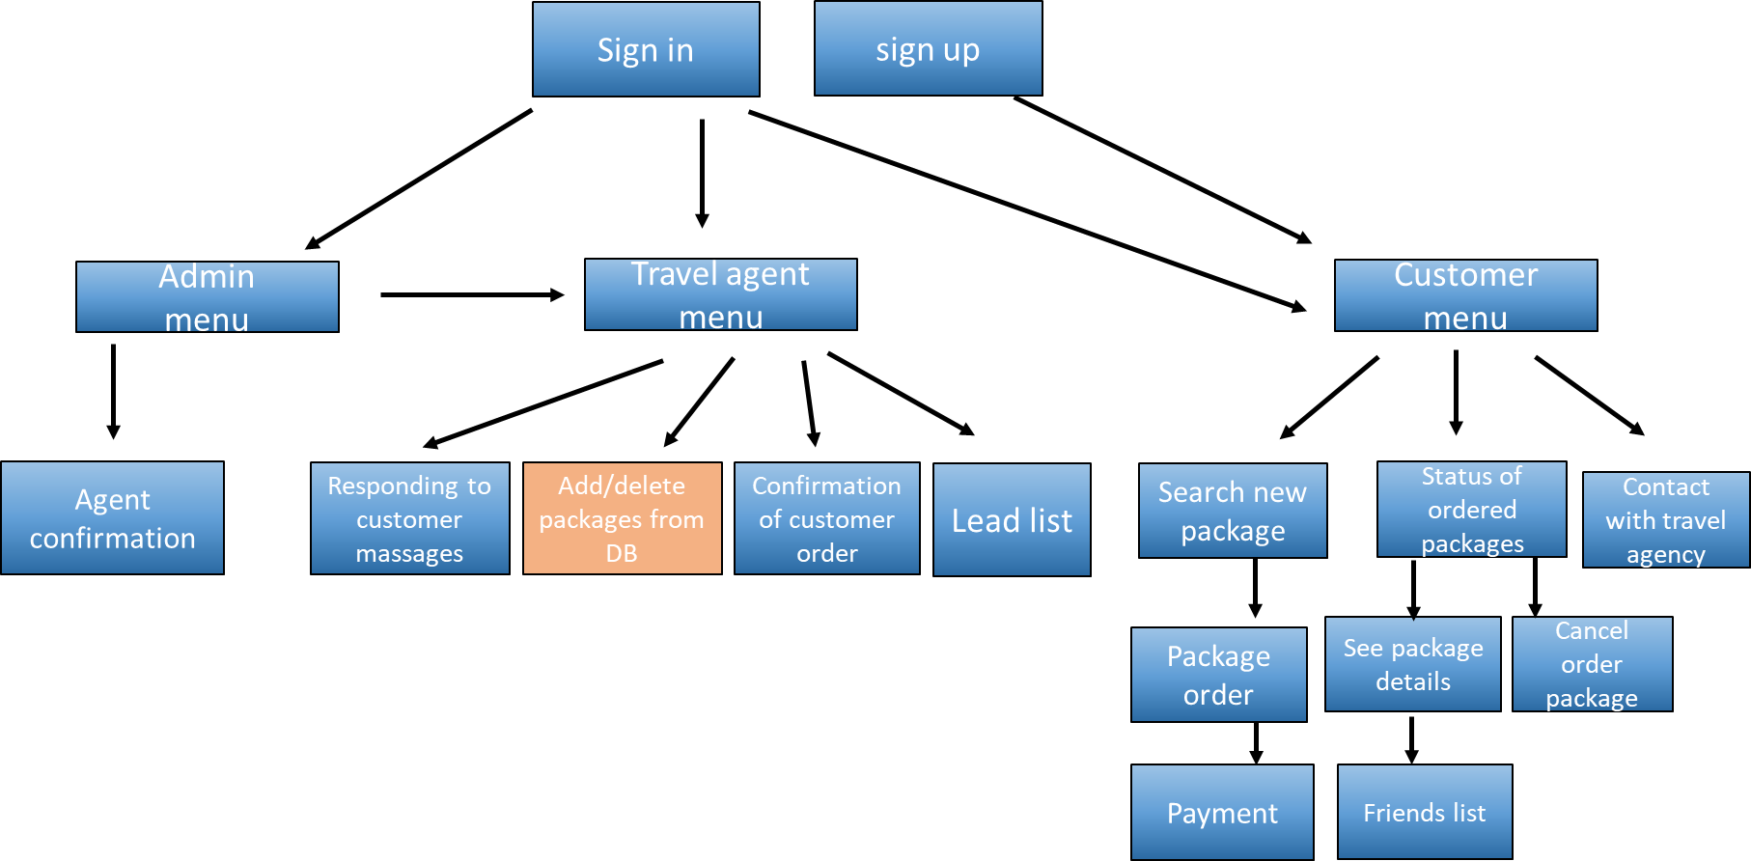

Add / delete packages from DB
quantity | price | flight number | flight company | hotel | return date | departure date | to | from
100 | 600$ | 222 | El Al | Fatal | 14/11/2021 | 01/11/2021 | Rio de jeneiro | Tel Aviv
77 | 370$ | 110 | El Al | Crown Plaza | 08/01/2021 | 02/01/2021 | Paris | Tel Aviv
150 | 250$ | 662 | Canada airlines | Hilton | 20/10/2021 | 10/02/2021 | Rome | Tel Aviv
 |  |  |  |  |  |  |  | +/ -
Delete package
Add package

Slide 10
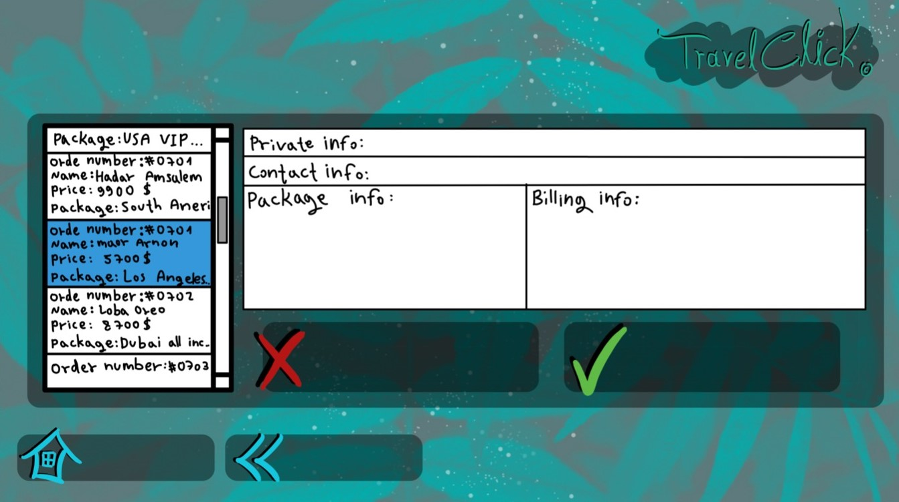
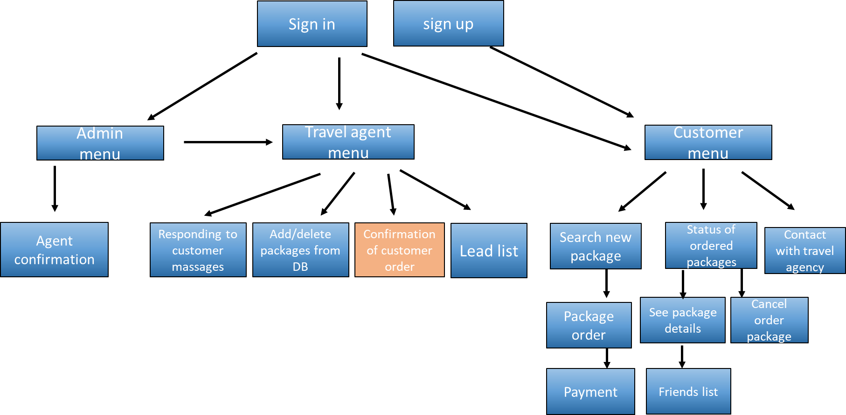
Travel orders
Decline
Approve
Home
Back

Slide 11

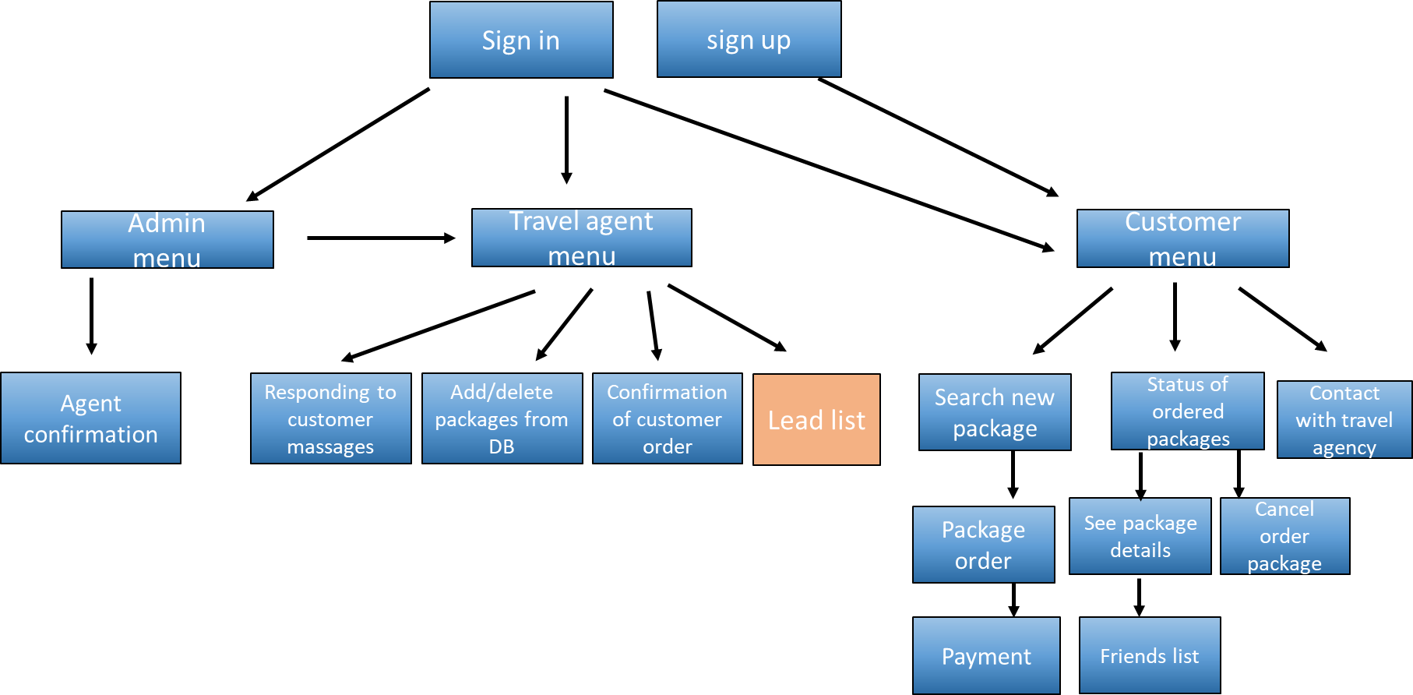
Lead list
First name Last name Phone Email
Liubov Vasilchuk 0535768736 luba@gmail.com
Home
Back

Slide 12

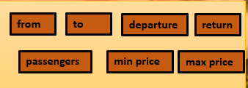
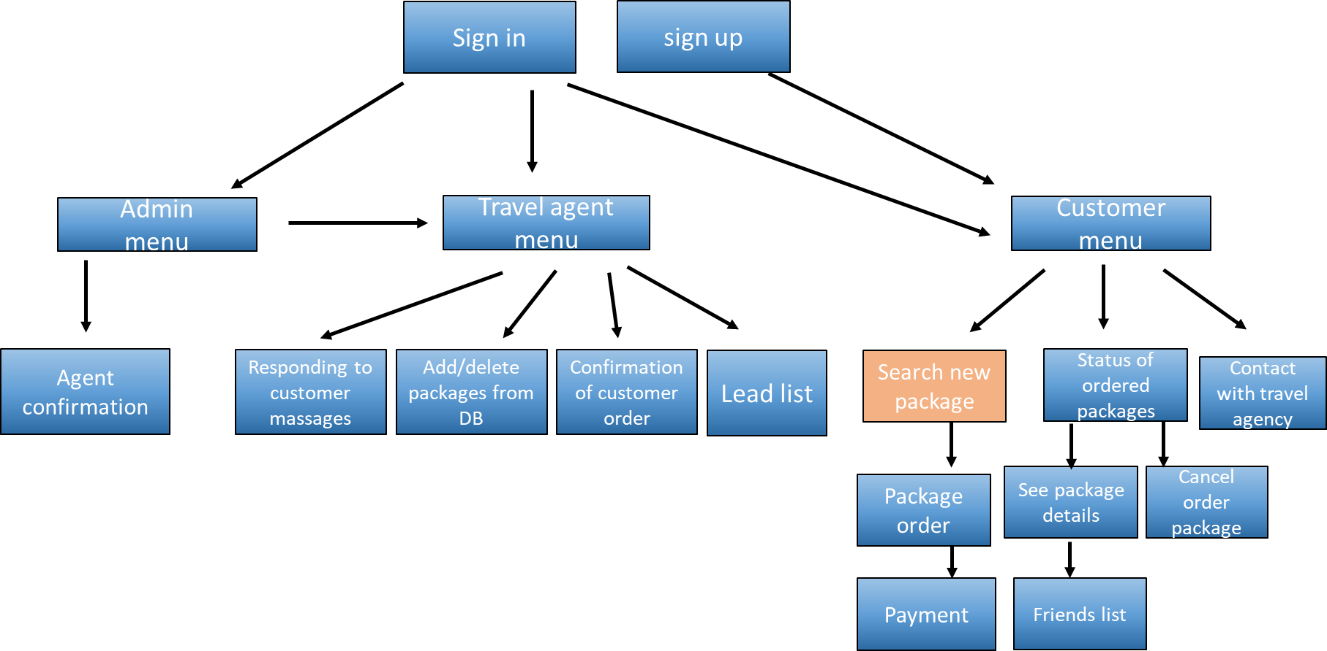

travelist
Find your dream vacation
from
to
departure
return
max price
Min price
search
search

Slide 13

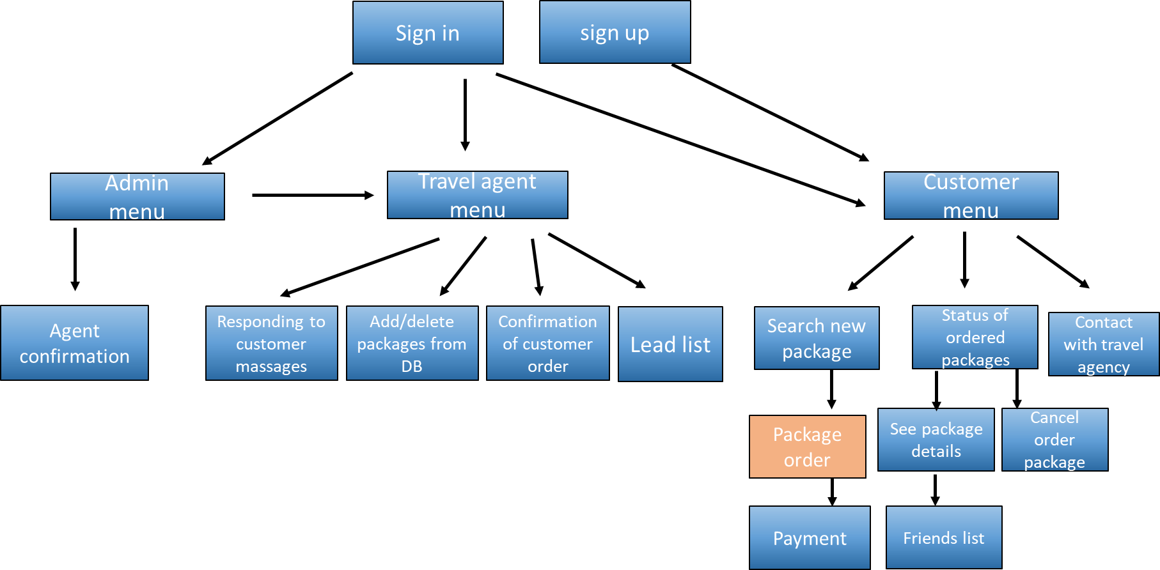
Departure date :10/11/21 Return date:24/11/21 To: Rome
Hotel: Crown plaza
Flight company: El Al Price:600$
Available :50 places
Available in Date:
Departure date: 11/11/21
Return date: 24/11/21
Click to order
Hotel: Hilton
Flight company: El Al Price:400$
Available :143 places
Available in Date:
Departure date: 10/11/21
Return date: 20/11/21
Click to order
Hotel: Rimonim
Flight company: El Al Price:150$
Available :10 places
Available in Date:
Departure date: 10/11/21
Return date: 24/11/21
Click to order

Slide 14
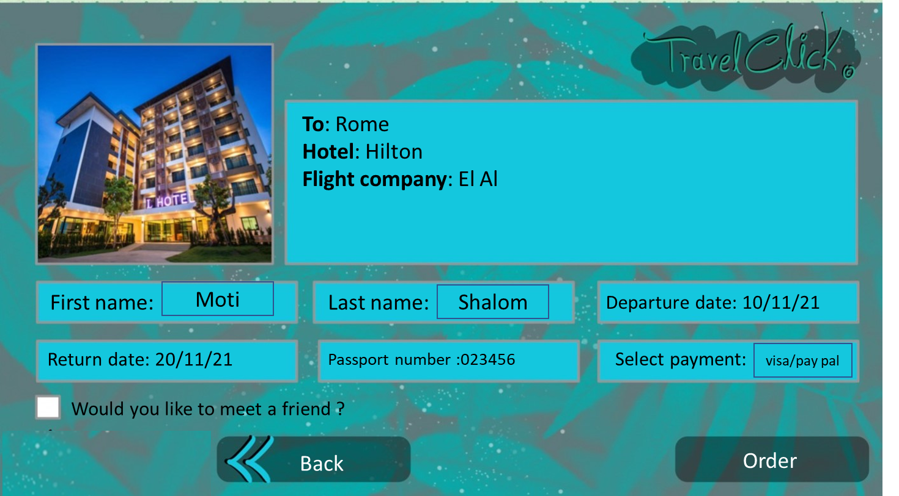
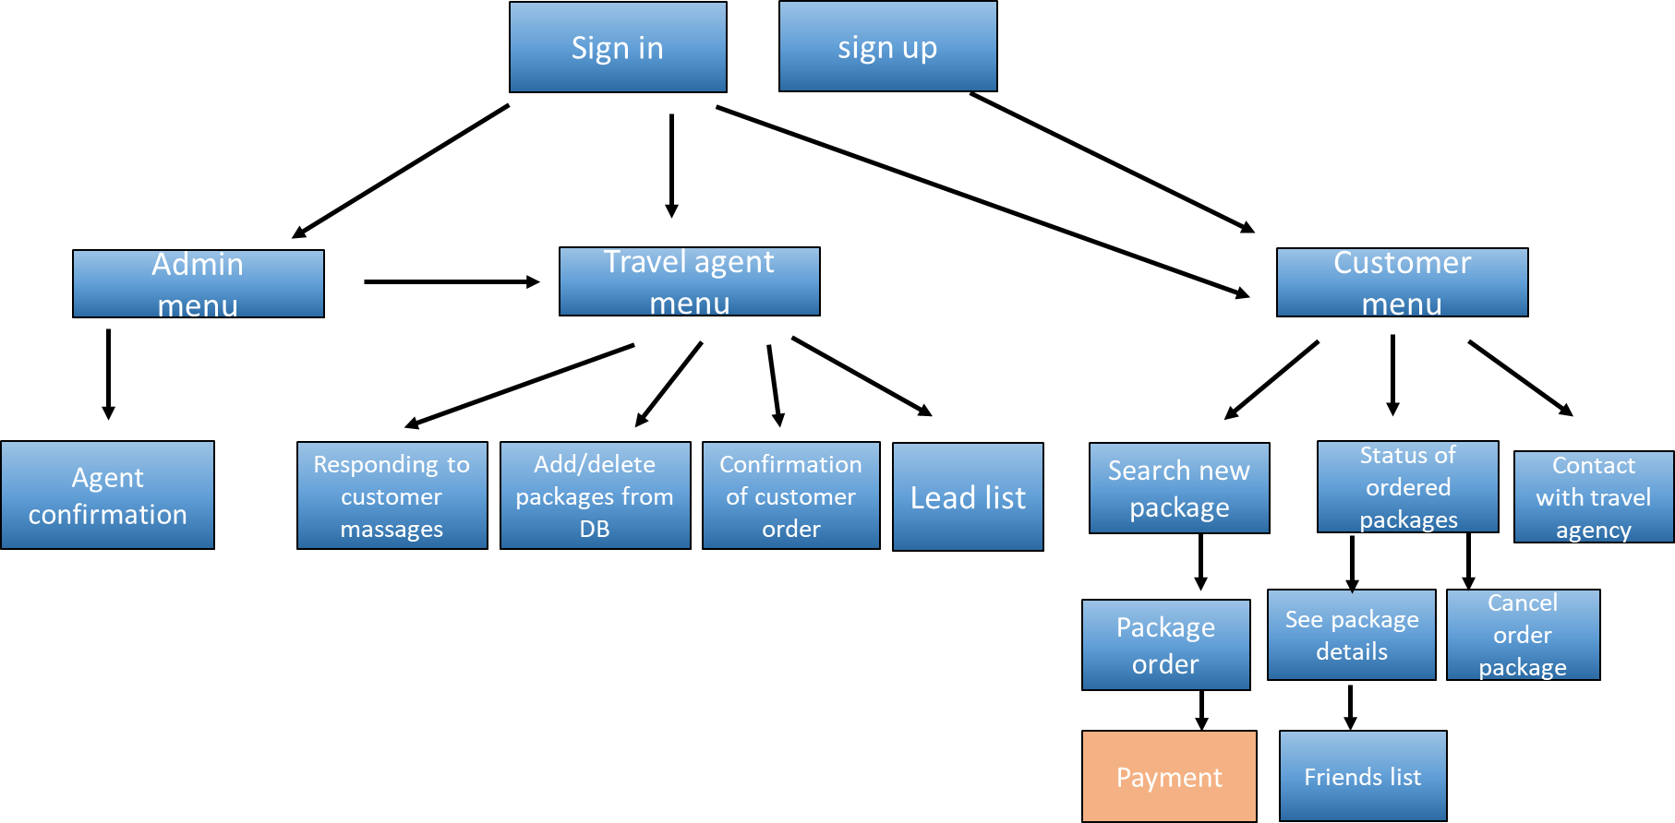
Card number:
Validity:
CVV:
Payment details:
You will receive appropriate advertisements related to your package

Slide 15
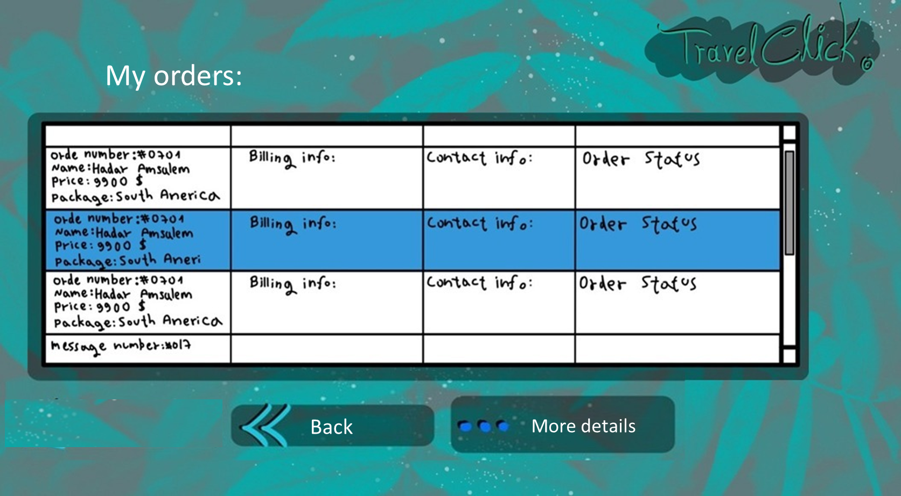
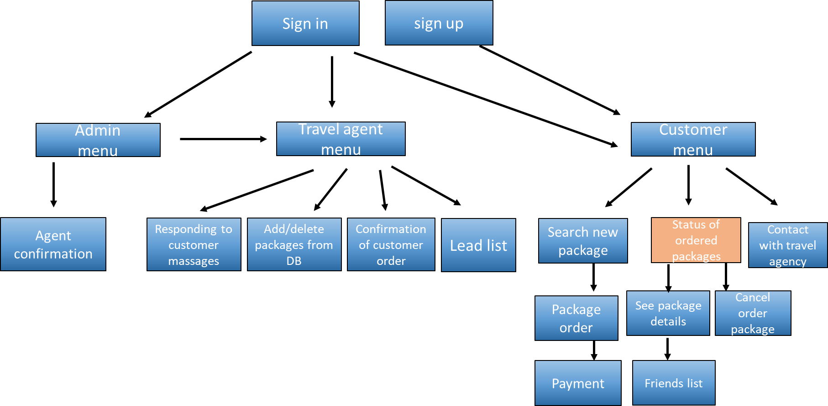

Slide 16
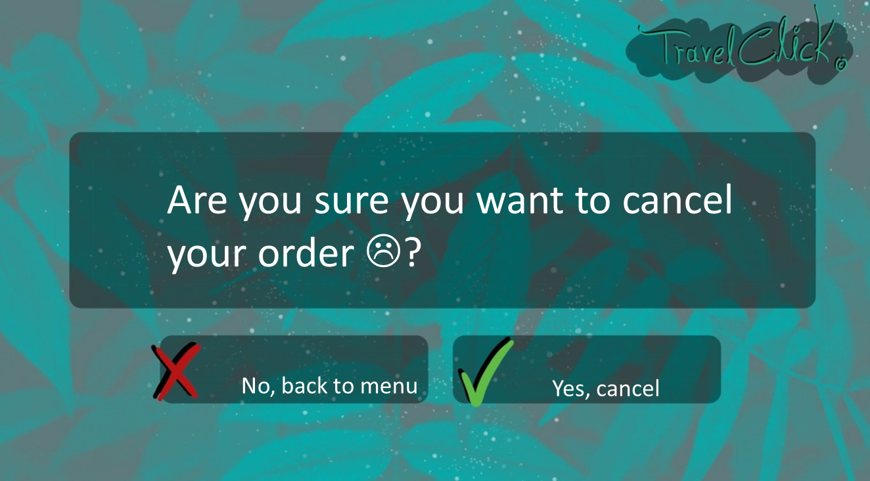
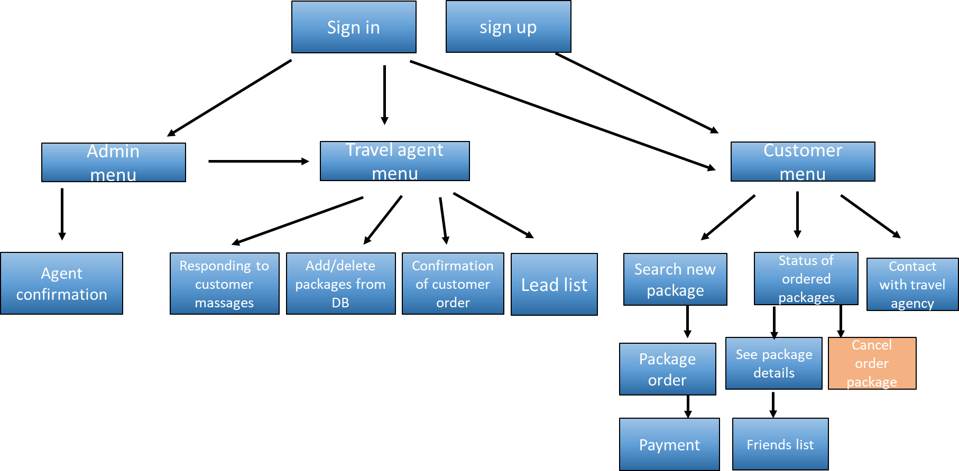

Slide 17
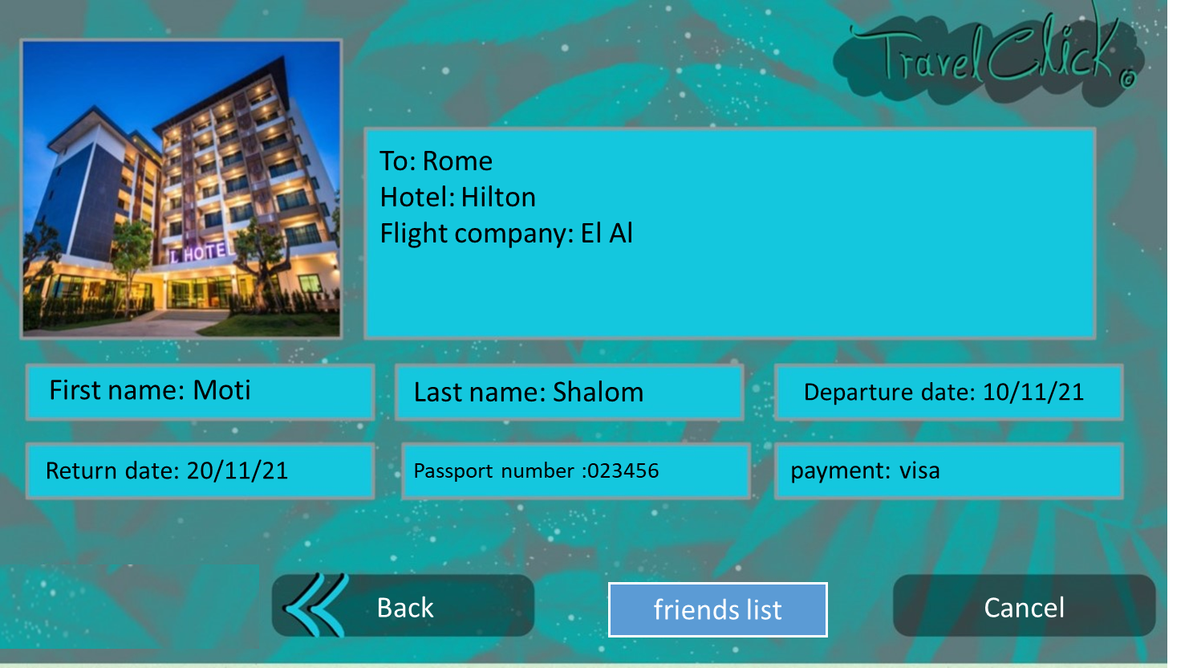
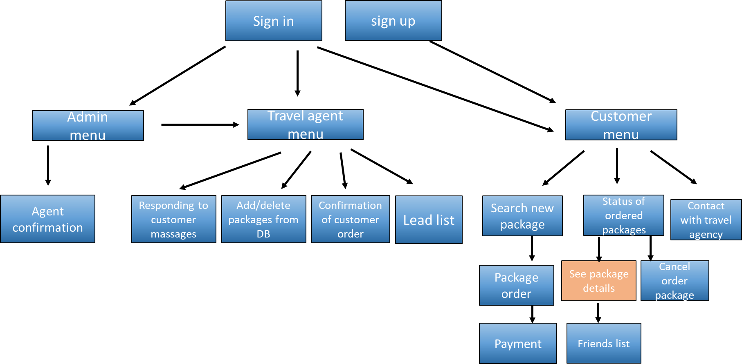

Slide 18
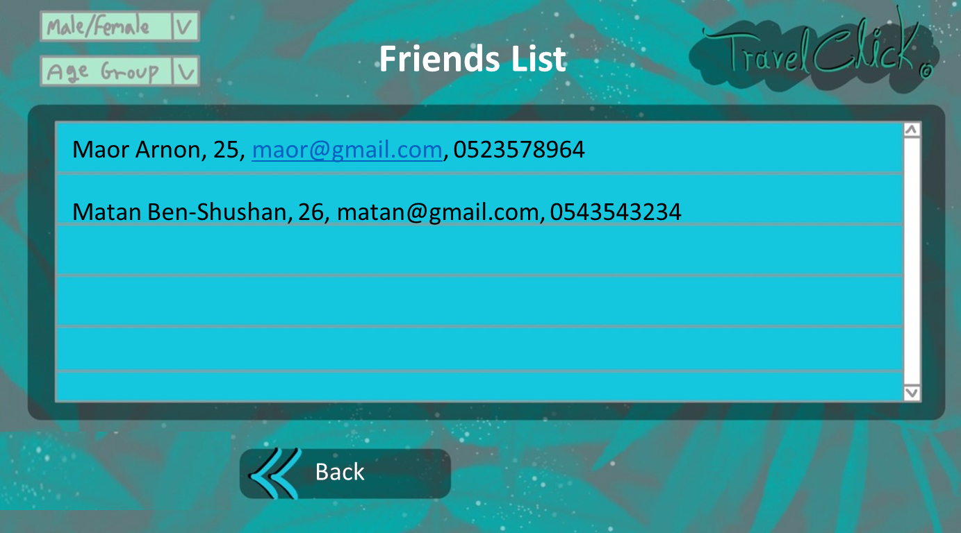
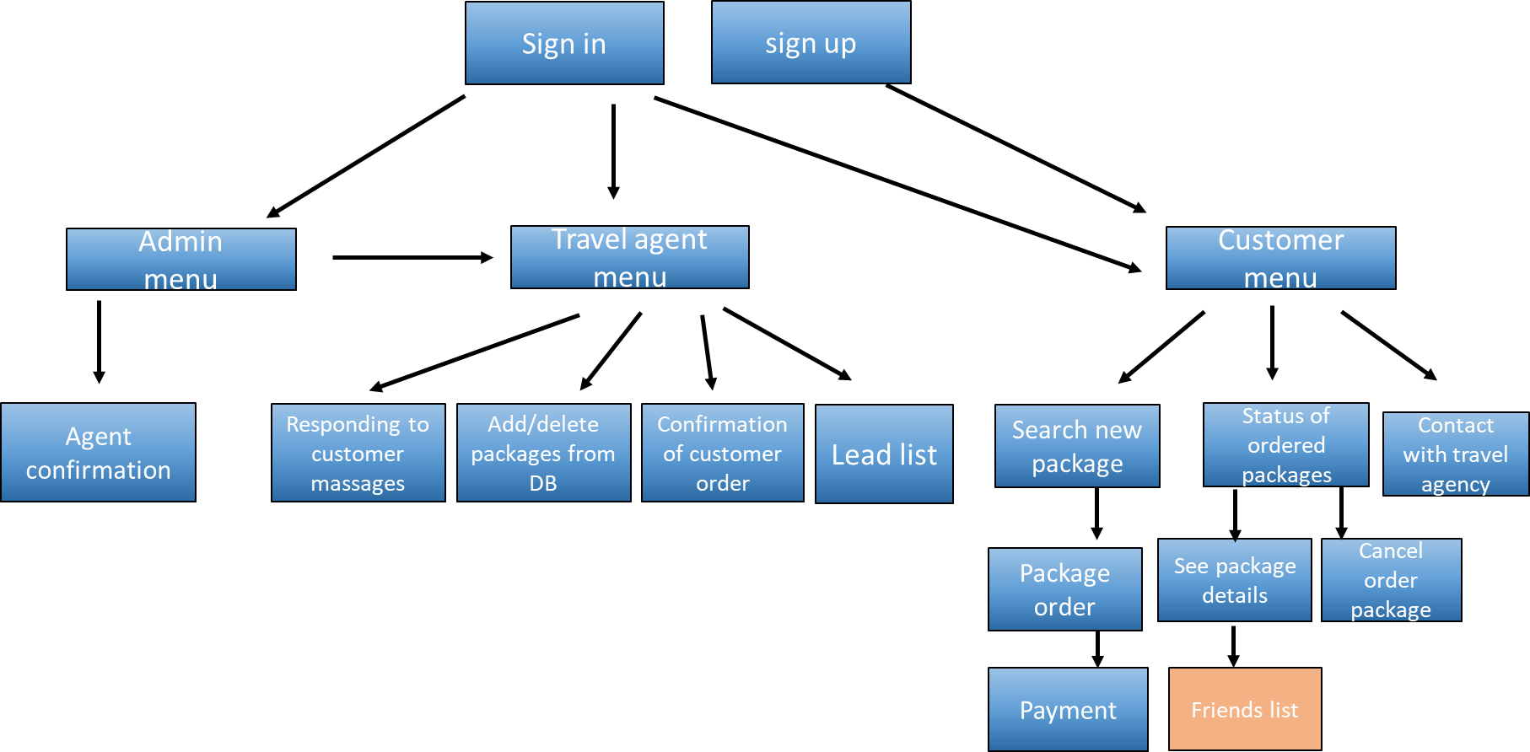

Slide 19
